Slide 1

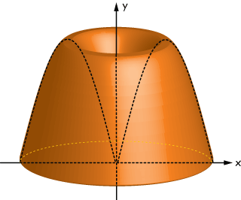


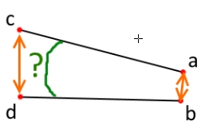
Part 12: What We Found, What We Have
- Obtaining Drawing Information

Slide 2
Objective Of This Lesson
Explain ways to input and retrieve information from a drawing.

Slide 3
Overview
CAD is constantly storing accurate, detailed information about objects in your drawing. You can utilize all this information at any time to get details through the use of commands that measure distances, calculate areas, angles, properties of objects, etc.

Slide 4
Showing Information of Your Drawing
At any time you can display the following types of information:
Information about selected objects.
Status of the current drawing.
Time spent working on the current drawing.

Slide 5
Calculating Distances and Angles
CAD accurately tracks every point location in the drawing in relation to the underlying Cartesian coordinate system, the program can very quickly calculate the distance between any two points that are selected.
Pick points A and B
A
Pick segments AC and BC
d
Angle
Calculated angle
“ n ” is displayed
Calculated distance “d” is displayed
B
C
o

Slide 6
Calculating Areas
You can easily calculate the area and perimeter of any enclosed object, or the area enclosed by a polygon that is formed by a series of points that you specify.
Pt.2
+
Pick points on objects to defined calculations
Calculated Perimeter “x-LF” and Area “x-sq. ft” are displayed
Pt.3
+
Pt.1
+
+
+
Pt.4
Close on Pt.1

Slide 7
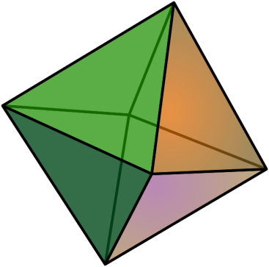
Calculating Volume
In most engineering CAD programs you simply type in a command such as “List” and select the object.
Calculated Volume
is displayed.
V= l x w x h
= [sum] cu. ft.
Select entire object

Slide 8
Additional Object(s) Information
Information about the drawing and objects can be stored and displayed in the following ways:
Tables can be created and/or inserted (attached) in the drawing.
Information can be embedded into the objects themselves, called Block Attributes.

Slide 9
Tables
A table is a compound object that contains data in rows and columns. It can be created from an empty table or a predesign template.
Drawing | Discipline | Number of sheets | % Complete
A-101 | Architectural | 100 | 80%
C-200 | Civil | 150 | 60%
E-100 | Electrical | 125 | 50%

Slide 10
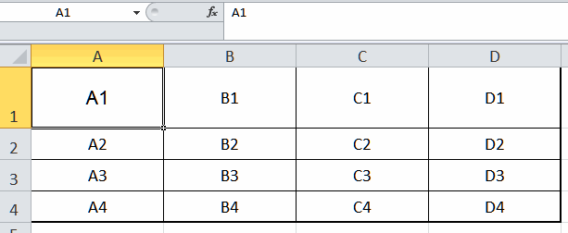
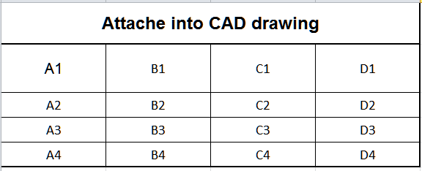
Tables/Spreadsheet
A table can also be linked to data in a spreadsheet.
Example of a linked
Microsoft Excel spreadsheet.

Slide 11
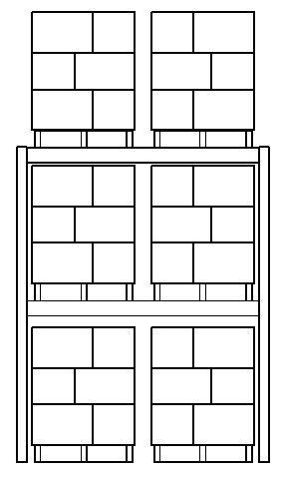
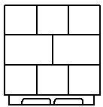
What are Block/Cell Attributes ?
An attribute is a label or tag that attaches data to a block. Examples of data that might be contained in an attribute are material, weight, dimensions, etc.
Plastic
PuPlastic Inc.
48x48
32 lbs.
See the following illustration.
Attributes
Type
Manufacturer
Dimensions
Weight capacity
Type
Wood
PalletRUs Corp.
48x48
40 lbs.
Manufacturer
Dimensions
Weight capacity

Slide 12
The preceding was just a general overview to make one familiar with what's involved in understanding and using CAD
Up Next:
Part 13: Uniting The Natives
- Combining Complex Objects

